Slide 1
Methods for Breaking Seed Dormancy
Several techniques can effectively break seed dormancy, depending on the type involved:
Chemical Treatments: Using substances like gibberellic acid (GA3), sulfuric acid, or potassium nitrate has been shown to enhance germination rates in seeds with physiological dormancy
Scarification: For seeds with physical dormancy, mechanical or chemical scarification can help break down the seed coat, allowing water to penetrate.
Moisture Control: Reducing seed moisture content through ultra-drying can also facilitate germination in certain species
.Temperature Treatments: Stratification methods involving either cold or warm temperatures can be used to mimic seasonal changes that trigger germination in dormant seeds
Light Exposure: Some seeds require specific light conditions to initiate germination; thus, providing light exposure can be crucial for breaking dormancy

Slide 2
Preparation of Seedbed
Seedbed preparation, a critical step in ensuring successful seed germination and establishment by creating optimal conditions for seeds to germinate by addressing soil structure, moisture retention, and weed competition. The methods and techniques used can vary significantly based on the specific requirements of the crops being planted and the environmental conditions.
Objectives of Seedbed Preparation:
Soil Moisture Retention: The seedbed should retain moisture near the surface to facilitate germination.
Weed Control: A weed-free environment is essential to reduce competition for resources.
Seed-to-Soil Contact: Good contact between seeds and soil improves germination rates.
Proper Seeding Depth: Ensures that seeds are sown at the correct depth for optimal growth
Nutrients efficiency enhancement.

Slide 3
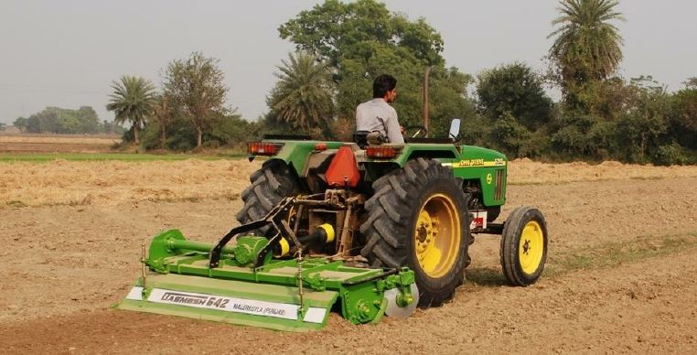
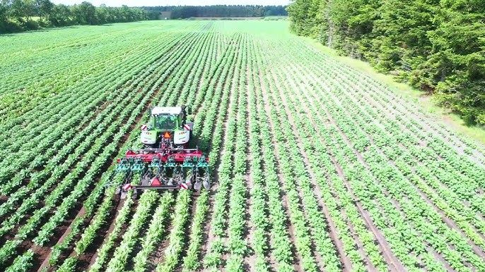

Slide 4
Seedbed Treatment Techniques
1. Tillage:
Primary Tillage
Secondary Tillage
2. Soil Amendments:
Organic Matter
Fertilizers
3. Weed Control:
Mechanical Weed Control
Chemical Weed Control
4. Pest and Disease Control:
Soil Fumigation
Soil Solarization
5. Water Management:
Irrigation
Drainage
Other Techniques:
Stale Seedbed Technique
Mulching

Slide 5
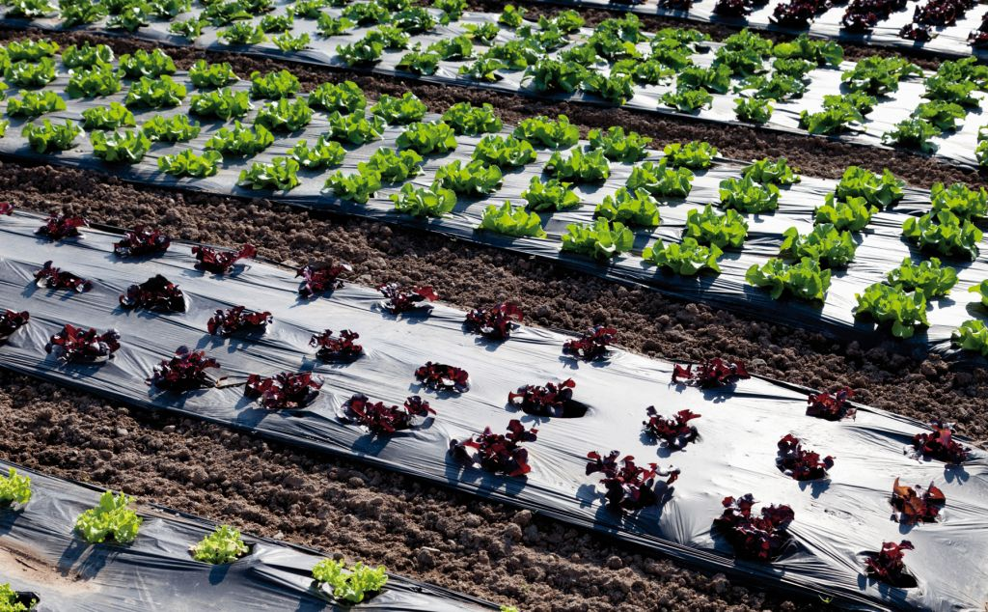
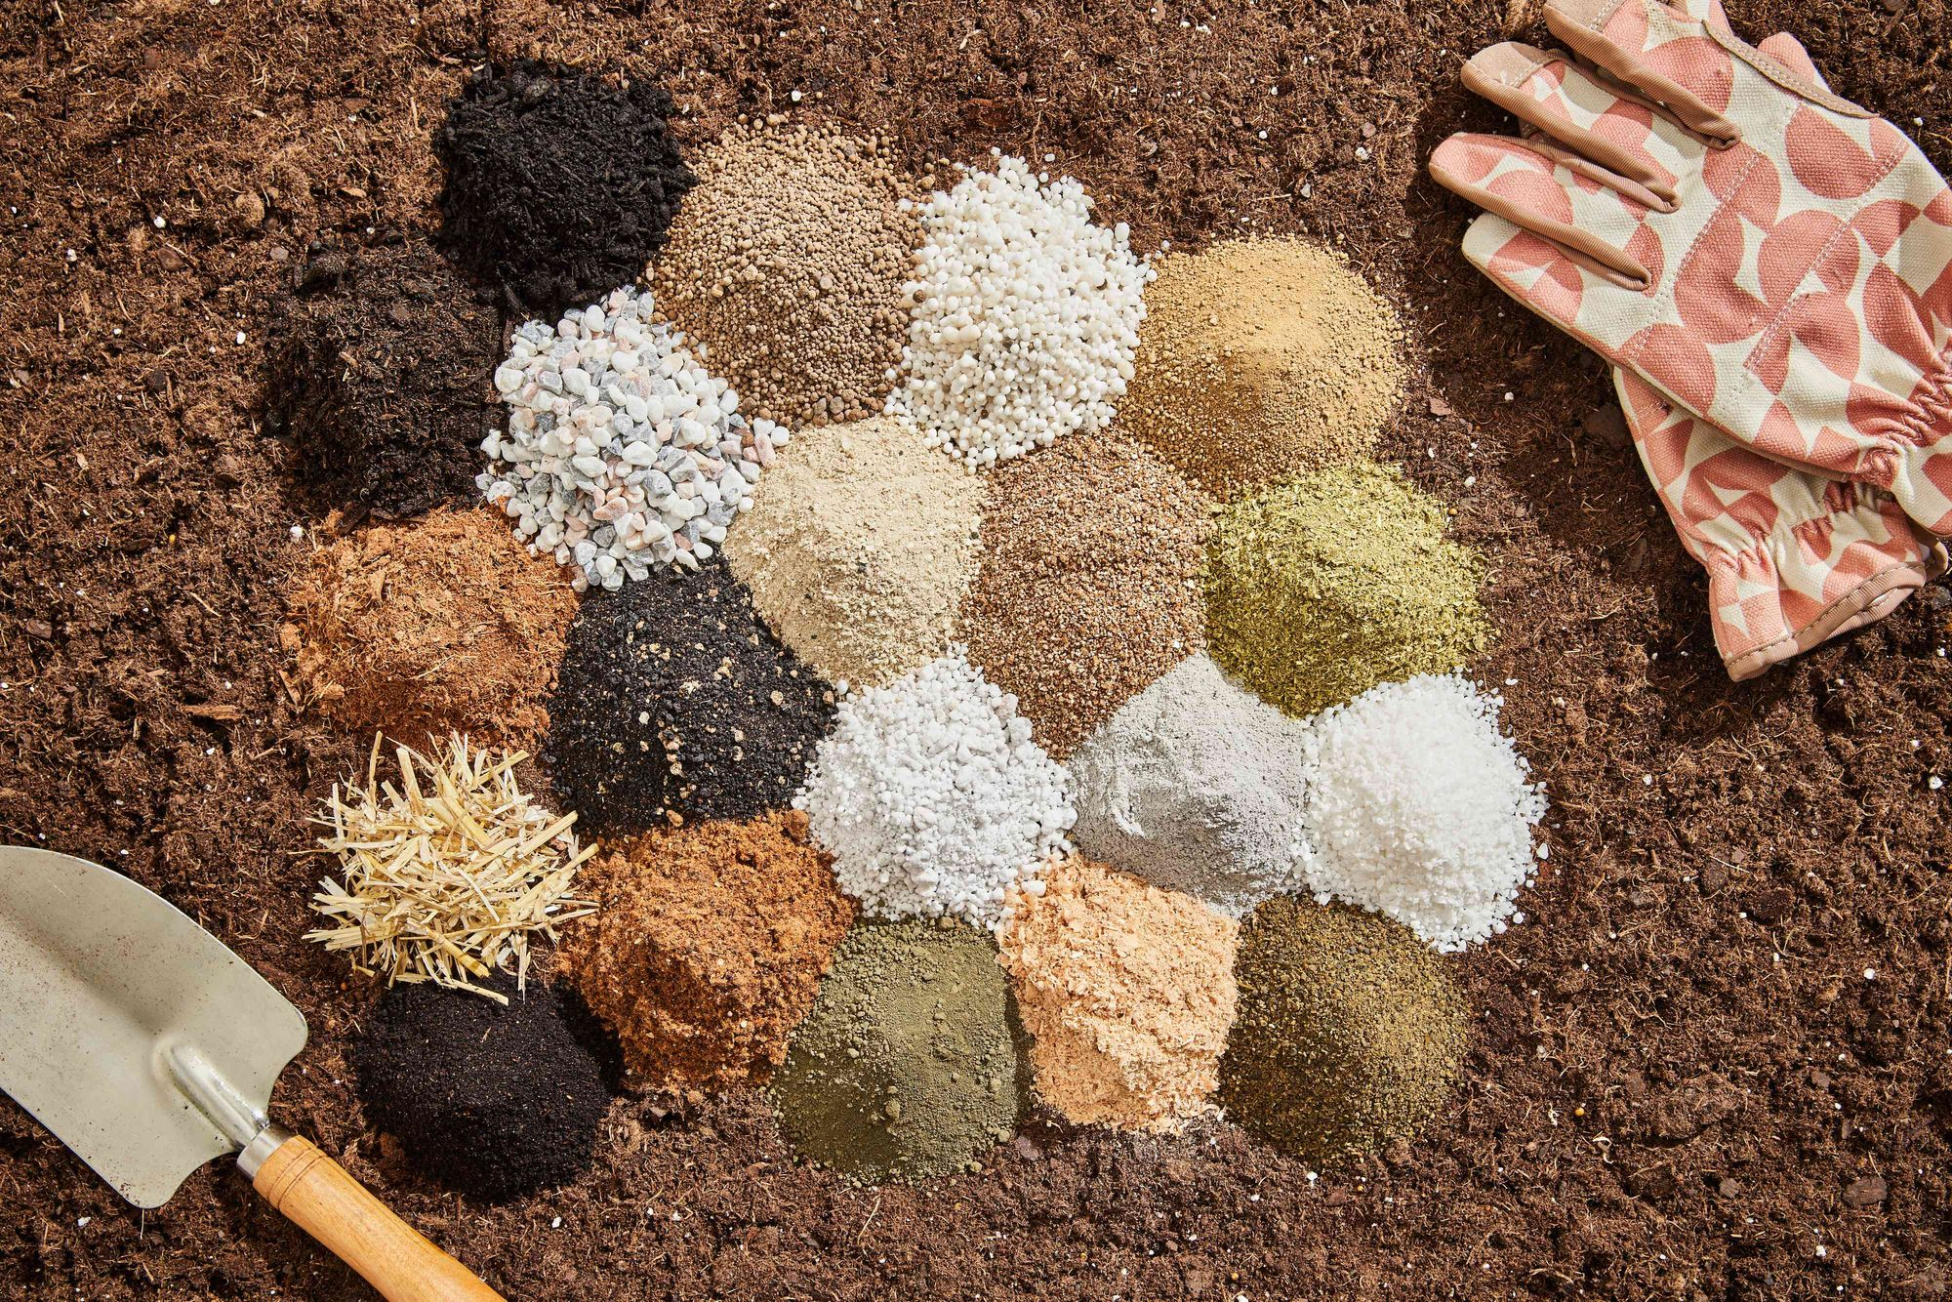

Slide 6
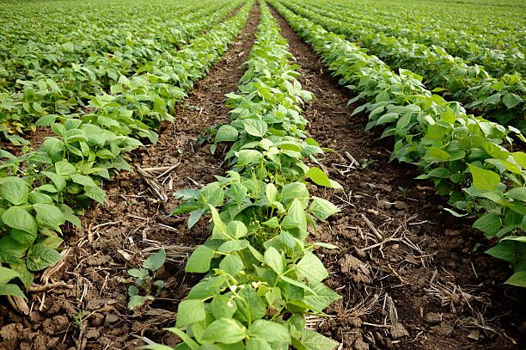

Slide 7
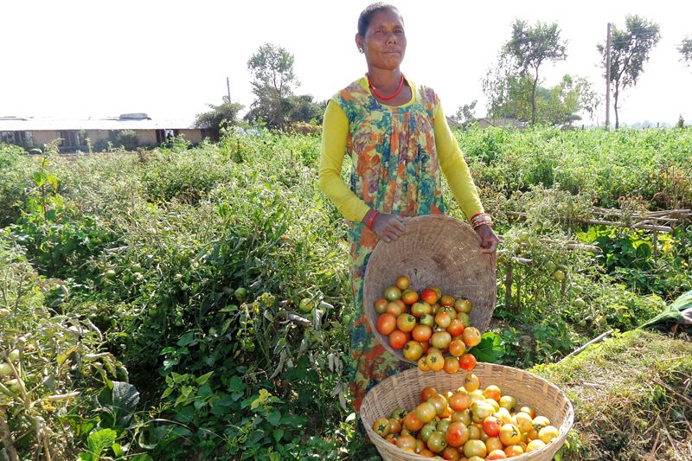
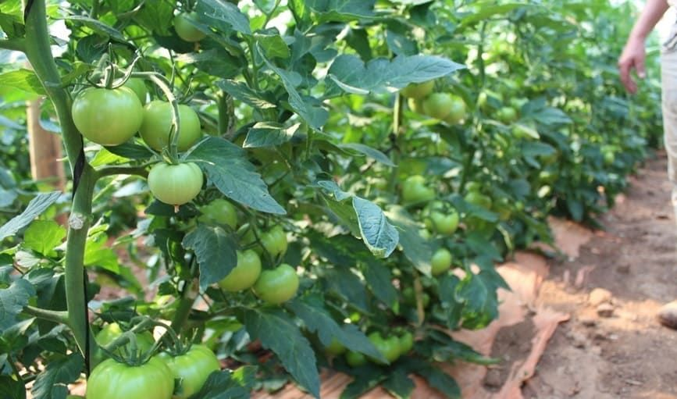

Slide 8
Advantages of Seedbed Preparation
Seedbed preparation is a fundamental practice in agriculture that significantly impacts crop establishment and yield. Here are the key advantages of preparing a seedbed:
1. Improved Soil Structure
Aeration and Texture: Proper seedbed preparation breaks up compacted soil, enhancing aeration and creating a fine texture conducive to root penetration and nutrient absorption
Moisture Retention: A well-prepared seedbed can help conserve soil moisture, which is crucial for seed germination and early plant growth
2. Enhanced Seed-to-Soil Contact
Uniform Germination: Ensuring that seeds are in close contact with the soil improves germination rates and promotes uniform seedling emergence. This is particularly important for achieving consistent crop stands.
3. Weed Control
Reduced Competition: Effective seedbed preparation helps control existing weeds by burying their seeds and disrupting their growth, thus reducing competition for resources such as water, nutrients, and light.
4. Increased Crop Yield
Optimal Growth Conditions: By creating an ideal environment for seed germination and growth, well-prepared seedbeds can lead to higher crop yields. Healthy seedlings established in optimal conditions are more likely to thrive throughout the growing season.
5. Enhanced Root Development
Access to Nutrients: A well-structured seedbed provides a conducive environment for roots to develop properly, allowing them to access nutrients more effectively.
6. Efficient Planting Operations
Smooth Surface: A well-prepared seedbed facilitates efficient planting operations by creating an even surface that allows for accurate seeding depth and spacing, ultimately leading to better crop establishment

Slide 9
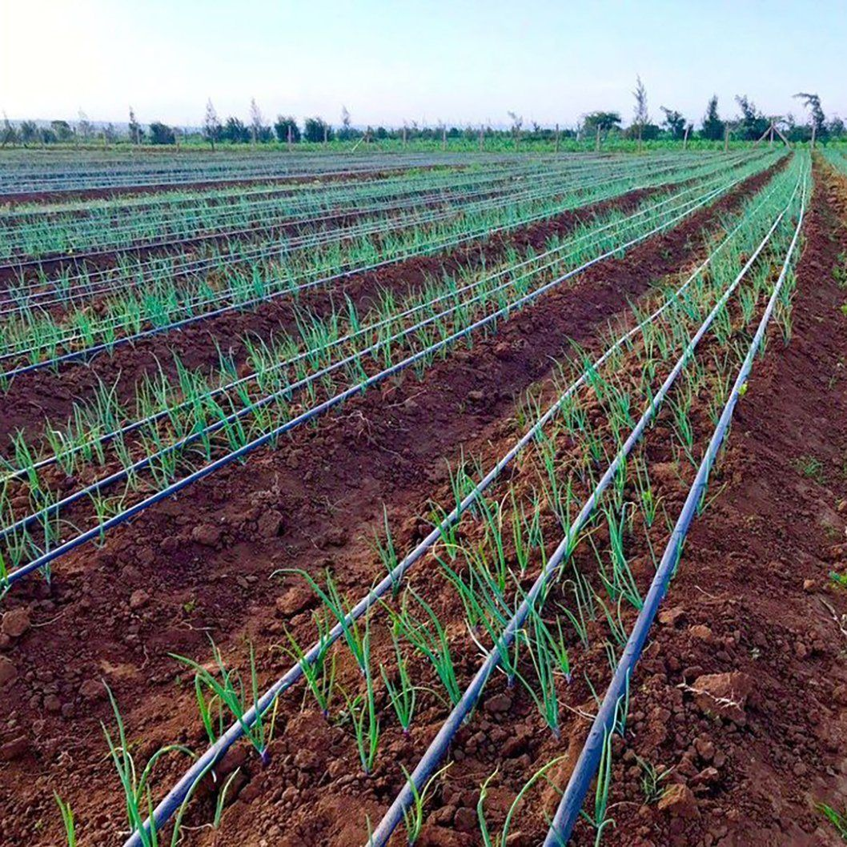
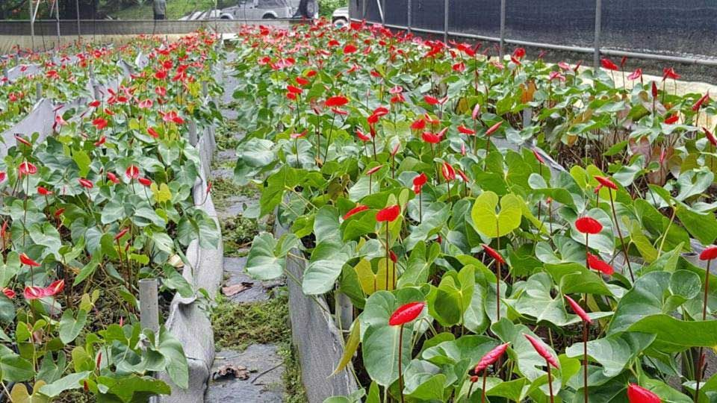

Slide 10
Care and maintenance of seedling
Provide Adequate Light: Seedlings need sufficient light for photosynthesis. Use grow lights or place them in a sunny location.
Maintain Consistent Moisture: Keep the soil consistently moist but not waterlogged. Overwatering can lead to root rot.
Ensure Proper Temperature: Most seedlings prefer warm temperatures, typically between 65-75°F (18-24°C). Avoid cold drafts.
Fertilize Regularly: Use a diluted liquid fertilizer specifically formulated for seedlings. Avoid over-fertilizing.
Monitor for Pests and Diseases: Regularly check seedlings for pests and diseases, and take action promptly to prevent further damage

Slide 11
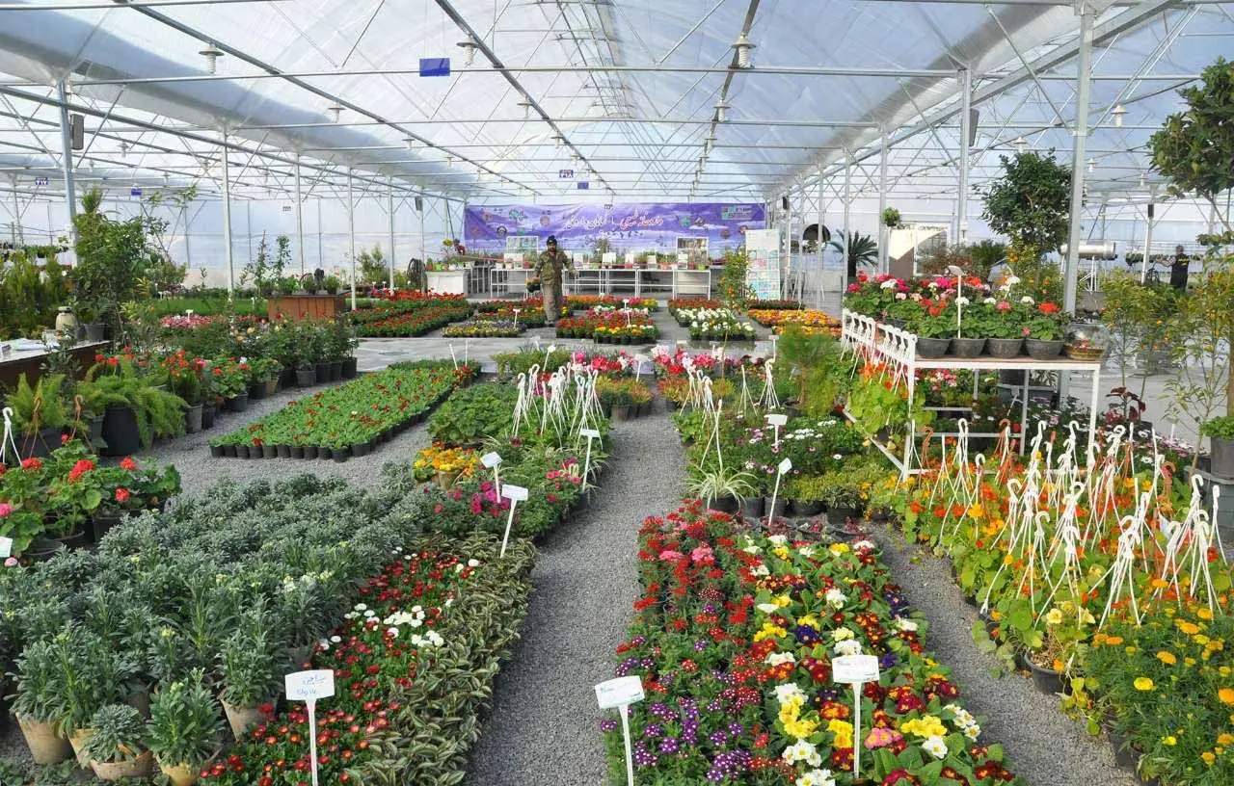

Slide 12
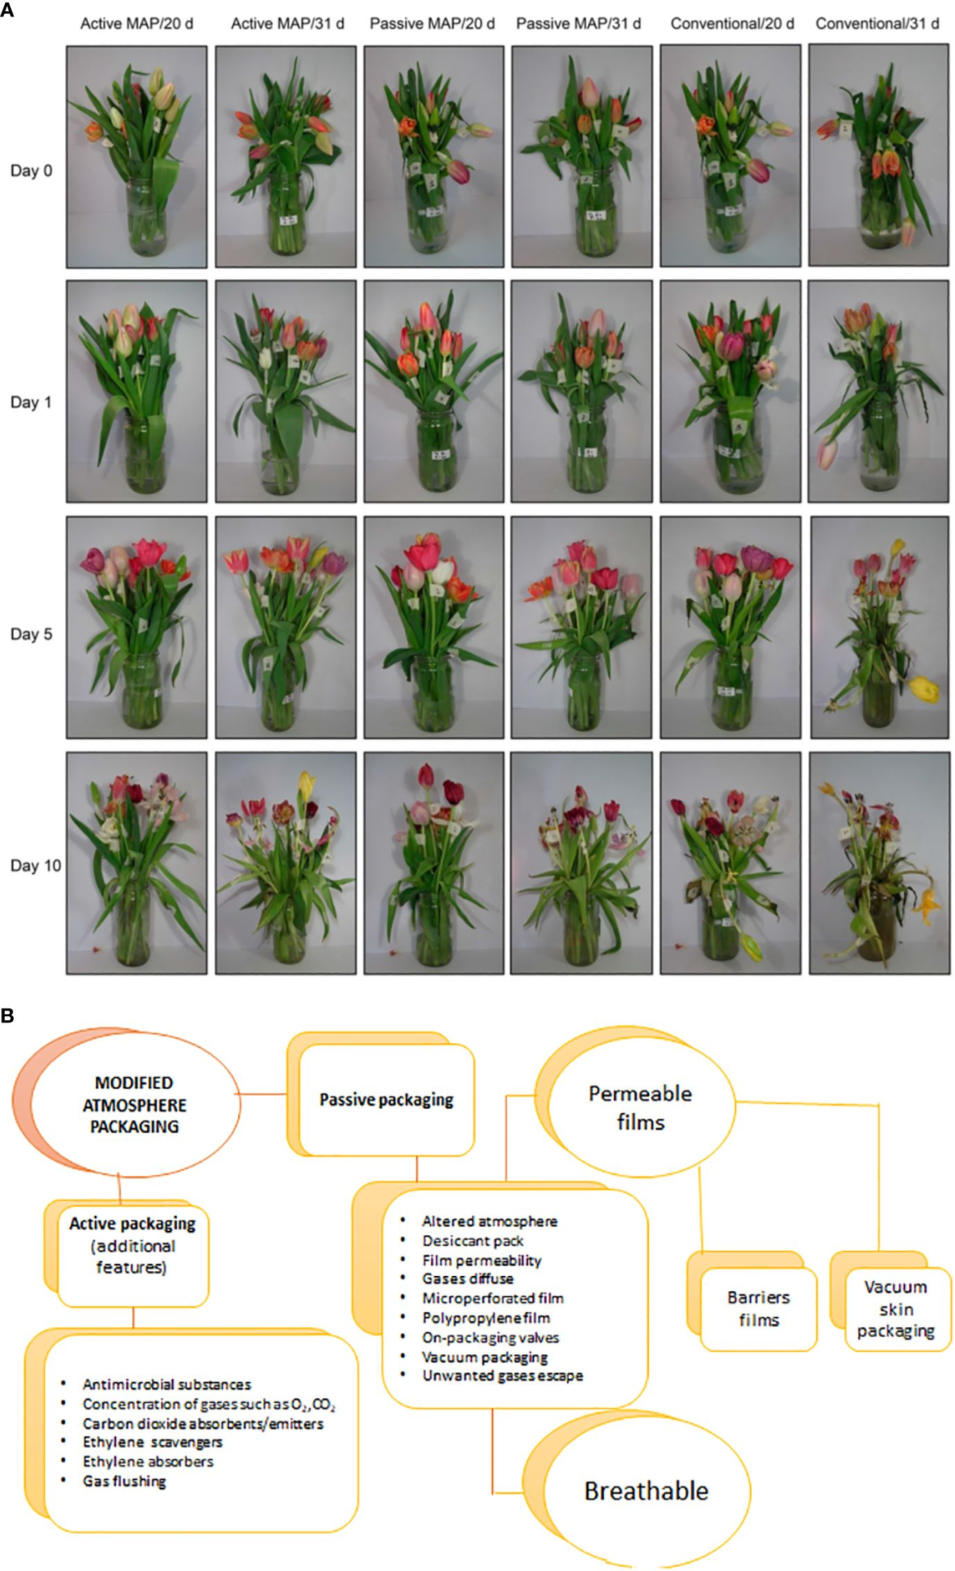
https://www.frontiersin.org/journals/plant-science/articles/10.3389/fpls.2024.1371100/full

Slide 13
Global floriculture market is experiencing robust growth, projected to increase from $321 billion in 2023 to approximately $353 billion in 2024.
This growth reflects rising consumer interest in ornamental plants for both personal use and commercial applications, such as interior decoration in offices and hospitality venues
Packaging Techniques
Vertical Packaging
Container Considerations
Moisture Retention
Cold Chain Logistics
Marketing Strategies
Linking Production to Demand
Cluster Farming
Quality Assurance
Year-Round Supply
Digital Marketing

